Slide 1
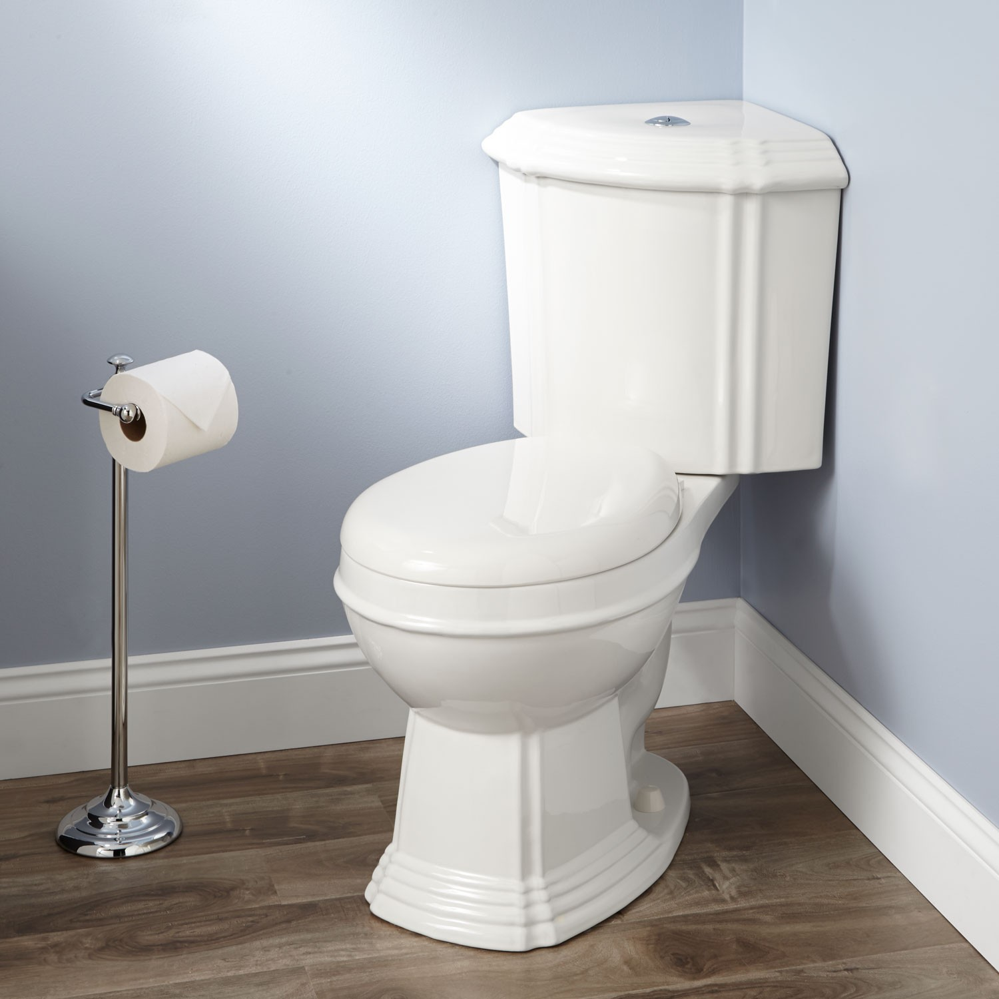
Good 2 Go
Because When You Have to Go,
Failure is Not an Option
Created by: Sean Cox, Eduardo Elias, Sydney Ross, and Jessica Llantada
Notes:
In today or in the near future, people will be traveling either to work, school, or to another planned destination. However, the social issue is that during the travel people need to use the restroom and travelers are unaware of decent facilities that they can use.

Slide 2
Social Reporting
Fishbone Diagram
Gender
Mobile
Lack of communication
Neutral
facilities
Consumer
Reviews
Lack of data
Family
facilities
Lack of locations
Travelers are unaware of Decent Facilities
Closed for cleaning
Good
Facilities
Lack of Care
Not fully stocked
Commercial
Facilities
Notes:
The Fishbone Diagram shows the defect which is that travelers are unaware of decent facilities. Currently, some facilities near highways are not equipped with sufficient equipment, lack cleanliness, or are temporary closed for various reasons. Only certain commercial facilities are clean but at time those may be closed to customers only. Social reporting would be a benefit for all if they report tips such as, “Clean location”, or “Hassel free.” It would also be useful to be aware if the facilities are gender natural or offer changing tables. This information could be resourceful on a mobile platform while individuals are on-the-go.

Slide 3
Fishbone Diagram
Social Reporting
Gender
Mobile
Locations of family rest stops
Consumer
Reviews
Wealth of data
Travelers commute in comfort…
Good
Facilities
Providers have incentives
Commercial
Facilities
Notes:
Travelers can reach their destination worry-free and in comfort knowing they can rely on the community to report their opinions on various aspects of their facilities. Mobile platform can provide a wealth of information such as ratings, tips, and reviews. This platform can become an incentive to provide clean and friendly facilities as their place of business will be advertised on this platform for an opportunity to gain more business and business transactions which could increase profits.

Slide 4
Business Motivation Model (BMM)
Mean |  | End
Mission |  | Vision
Provide an incentive for facilities providers to keep their facilities clean. Give everyone else a way to find these facilities |  | Easy to find, clean facilities
Course of Action |  | Desired Result
Strategy |  | Goal
Implementing rating system, direct people toward facilities with positive ratings create an easy to use app |  | Provide an accurate rating system for all public facilities
Tactic |  | Objective
Develop app, database, advertising research partnerships w/providers, "worst 20 places to go" |  | 80% of rating area is cataloged and rated
Directive
Business Policy |  | Assessment
Run crime stats all rated/advertised areas
Business Rule
Never advertise in high crime areas
Influencer
External influencer
App user providing feedback
Internal influencer
Notes:
Overview….

Slide 5
Mean
Mission
Provide an incentive for facilities providers to keep their facilities clean. Give everyone else a way to find these facilities

Slide 6
Course of Action
Strategy
Implementing rating system, direct people toward facilities with positive ratings create an easy to use app
Tactic
Develop app, database, advertising research partnerships w/providers, "worst 20 places to go" Best 10 women’s restrooms

Slide 7
Directive
Business Policy
Run crime stats all rated/advertised areas
Business Rule
Never advertise in high crime areas

Slide 8
End
Vision
Easy to find, clean facilities

Slide 9
Desired Result
Goal
Provide an accurate rating system for all public facilities
Objective
80% of rating area is cataloged and rated

Slide 10
Influencer
External influencer
App user providing feedback
Internal influencer
Notes:
To avoid any accusations of bias, we want to avoid as much as possible directly avoid any ranking generation itself.

Slide 11
BPMN Business Process Model and Notation,

Slide 12
Notes:
The customer writes the reviews and submits location and experience details. This data is then updated to the moderator for review. The review is verified and stored into the database. The owner receives a notification of the content for response. Customers and owners can search the database for the latest content details. The database can be updated by the owners when they submit feedback on status changes to the facilities. The database can also be updated on customer reviews which then gets posted to the platform. The customer will receive a notification that their post has been posted for other customers to use while using the system to find a facility.

Slide 13
Notes:
The third class of user is the health inspector: They would query the database based on a geographic area basis, to see if there are places that should be visited.

Slide 14
Notes:
Starting at a "Reviewing User", they submit a review. This data is subjected to an automated sanity check for geolocation, swear words, and other data details check. Once it clears, the automated review is forwarded as a "compiled" review to human moderation. If the review is rejected for any reason, the rejection is sent back to the reviewer for correction. If it is accepted, it is added to the primary database.
A business owner may query for properties they control, and if desired, they may submit remediation reports, stating if problems were fixed. The reports are also subject to the same moderation as user reviews.
Users looking for facilities can query all listings, and receive the desired results. After using a listed and reviewed facility, they are given the option to submit a simple yes/no review, asking if the facility matched the review. For this diagram, government health inspectors are in the same role as standard users, that only receive search results.

Slide 15
Org Chart

Slide 16
Notes:
The following are the three entities that make up our organizational stake holders.
First, we have the business. The business can include any and all places that travelers and commuters may stop to use their facilities and possibly engage in an economic interaction. At the top of any business is the owner, who imposes business rules on the managers, who further imposes and implements the rules onto the employees running the day to day operations at the business.
Second, we have the governmental bodies. The governmental bodies are comprised of executive positions, who are elected by the commuter communities and who impose regulations on businesses and business owners. The heather inspector and health supervisors report to the executive governmental figures, and have the ability to fine businesses who aren’t complying with regulations.
Lastly, we have the commuter communities, who can patronize a business’ quality of services provided, and who vote in the governmental figures. This organization is made up of the users and reviewers.

Slide 17
Use Case Diagram

Slide 18
Notes:
The use case diagram is based off the BPMN which shows how the customer can create reviews from posting location, experiences, and recommendations as well as the customer can search location review of the near by facilities. The diagram also shows that the owner can do similar as the customer but with the differences that the owner have to chances to fix the issues that customer commented on and update the review.

Slide 19
Wire Frame

Slide 20
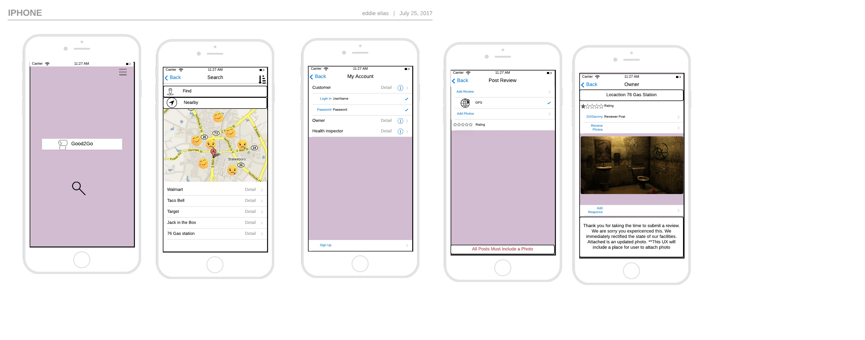
Wire Frame
Notes:
This application of Good 2 Go is a user friendly platform that is easy to search for facilities that are in your local area utilizing your geolocation on your smartphone. The user has two search options: Nearby which locates facilities near you or the user can search by entering a business name or address of a location. The results are listed below and based on reviews, you’ll see good smiley faces or frowning faces.

Slide 21
Notes:
Users can create an account to post reviews and save their submitted reviews. When posting a review, the user must be in a near location of the facility they are providing feedback on. There is a requirement of a review, which is providing a photo. Then, the user can select their star rating based on 5 star scale. The last picture is an example of a bad comment review that an owner has access to which they responded to their customer thanking them for their time and offered their sympathies. They also fixed the issue and provided proof with an updated picture.

Slide 22
Database ERD

Slide 23
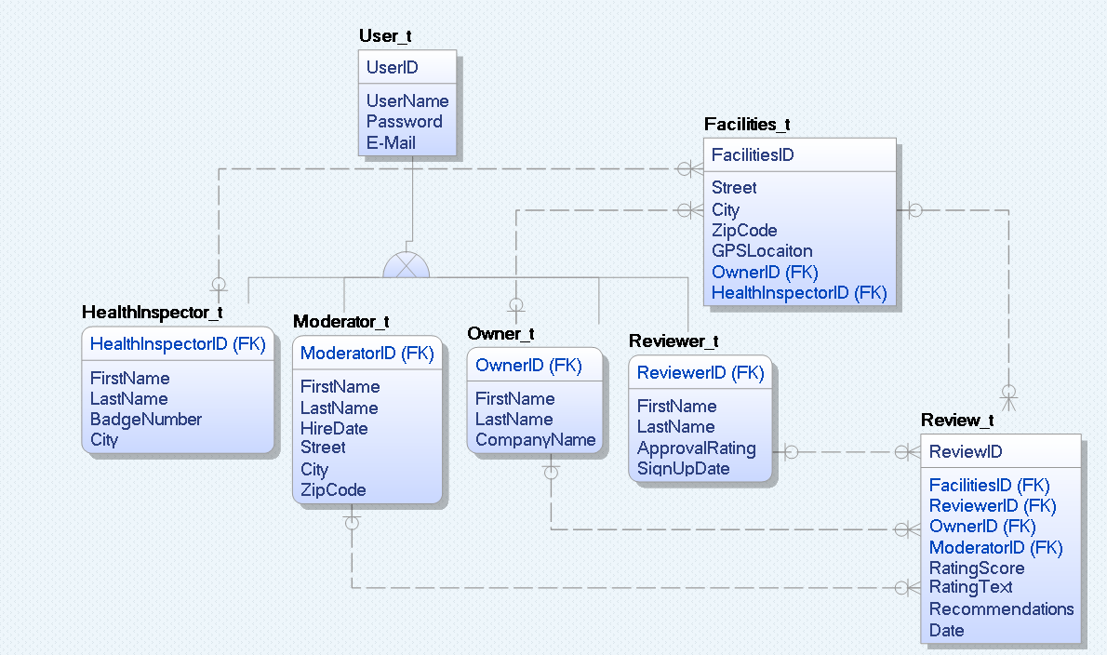
Database ERD
Notes:
This is the ERD for Good 2 Go. Lets start with the user that contain a primary key of User ID with the attributes of name, password, and email. The User can be only one of the fallowing option wither a Moderator, owner, reviewer , or health inspector. The Review table have a Facilities ID in which where the review base on and the Reviewer ID to show who wrote the review. Also review table as a Owner ID to show who owns the facility and the Moderator ID to show who check the review before it gets update to the database. As for the Health Inspector have access to the facilities.

Slide 24
Class Diagram

Slide 25
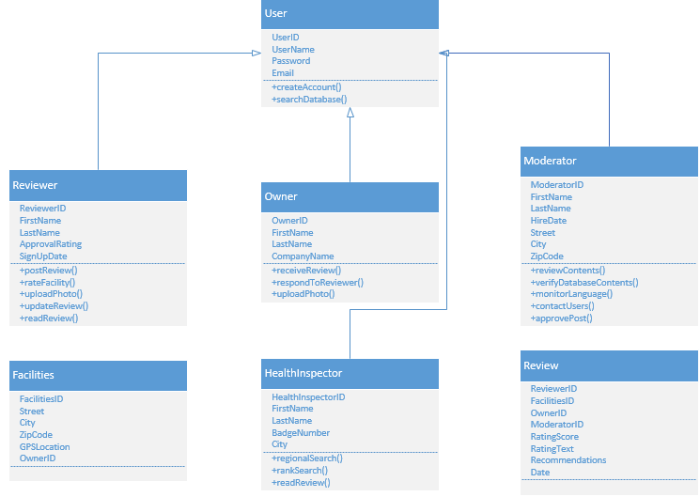
Class Diagram
Notes:
The Class Diagram is a static structure diagram that provides a view of the system by showing the system’s operations and relationships among objects. The User class requires a user id, username and password using the client’s email. The reviewer also requires a reviewer id along with all their personal information which their average approval rating. The facilities class provides the physical address and GPS location. The reviewer is a class that holds most of the ID’s with the text comments and timestamps the entry. The moderator has their details along with their vetting criterial to assure the comment are within the terms and conditions of Good 2 Go.

Slide 26
Activity Diagram

Slide 27
Activity Diagram
Notes:
This activity diagram outlines the actual activity upon signing into the G2G app. It includes the activities that would occur from the standpoint of the reviewer, owner, and moderator. It also includes condition checks, and depending on the binary response (yes or no), it then travels to a different segment of the process.

Slide 28
Sequence Diagram

Slide 29
Sequence Diagram
Notes:
Here is where you can see how the sequence in logging in the app. As a user you have either log in as a reviewer, owner, health inspector. Then the system check which user you are and give the permission setting to the right user. As a Reviewer you have to write a review that get sent to the Moderator for checking if the review contain any profanity or incorrect GPS coordinates a message will be sent to the Reviewer. Owner get access to the database only to see their facilities rating and review and if the owner what to write a response to the reviewer or update fixes to the facilities it must go through the Moderator where either the moderator sends the message to the reviewer or update the database. Lastly, the Health Inspector bypass the review and Moderator Part and get access to the database to look up facilities, reviews from the reviewers, and responses of the Owners.

Slide 30
AWS Diagram

Slide 31
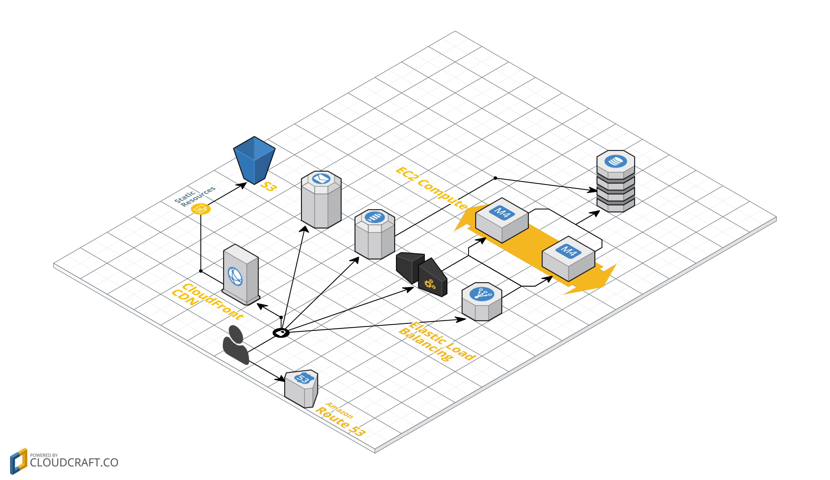
AWS Diagram
Notes:
Route 53 provides name resolution, and CloudFront provides distributed CDN to all static elements.
SES is for email for staff, and outbound communications for users that opt-in.
SNS with a link to the back-end DynamoDB for push notification support.
API component for 3rd parties to access data, linked to an expandable EC2 group.
Elastic load balancing proxy to the expandable EC2 group, and finally the DynamoDB instance.

Slide 32
PESTLE Diagram

Slide 33
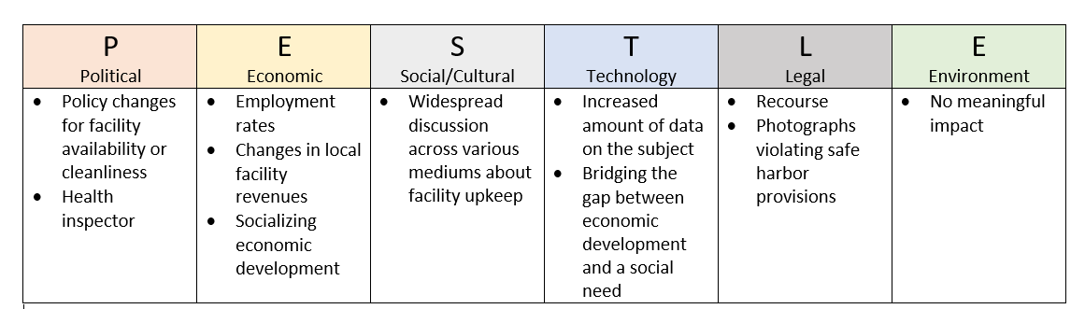
PESTLE
Notes:
With PESTLE analysis give a multiple view that the Good 2 Go will affect. For Political the app may change policies on how the facilities are clean and cause facilities we visit by health inspector more regularly. As for Economic the app may affect the employment rate by which the location will need more employees keep up facilities and base on the facilities will change the revenues and the development of the economy. For Social and culture, the app will give people the ability to be heard which will open a widespread discussion about facilities upkeep. For technology, there will be a increase of data on the facilities and will bridged the gap in developing economic with social needs. As for Legal, the app will cause a problem with photos violating safe harbor provision which will need an recourse. Lastly, Environment which there is no foreseeable affect that the app will purpose to the environment.

Slide 34
Venn-Diagram

Slide 35
Venn-Diagram As-Is
Venue
City
Visitor
Clean, safe, accessible facilities
Many venues and business locations
Facilities including restrooms, items for purchase, experience
Increased revenue
A place worth stopping
Notes:
As-is, there is a gap between the venue and visitor relationship. The next diagram is the proposed solution via G2G app.

Slide 36
Venn-Diagram To-Be
Venue
Visitor
Attract paying customers
Clean, safe, accessible facilities and other amenities
Incentive to visit
Notes:
With an incentive to visit, the venue and the visitor are directly linked. G2G app can provide this missing link by hosting a wealth of user supplied data on facilities.

Slide 37
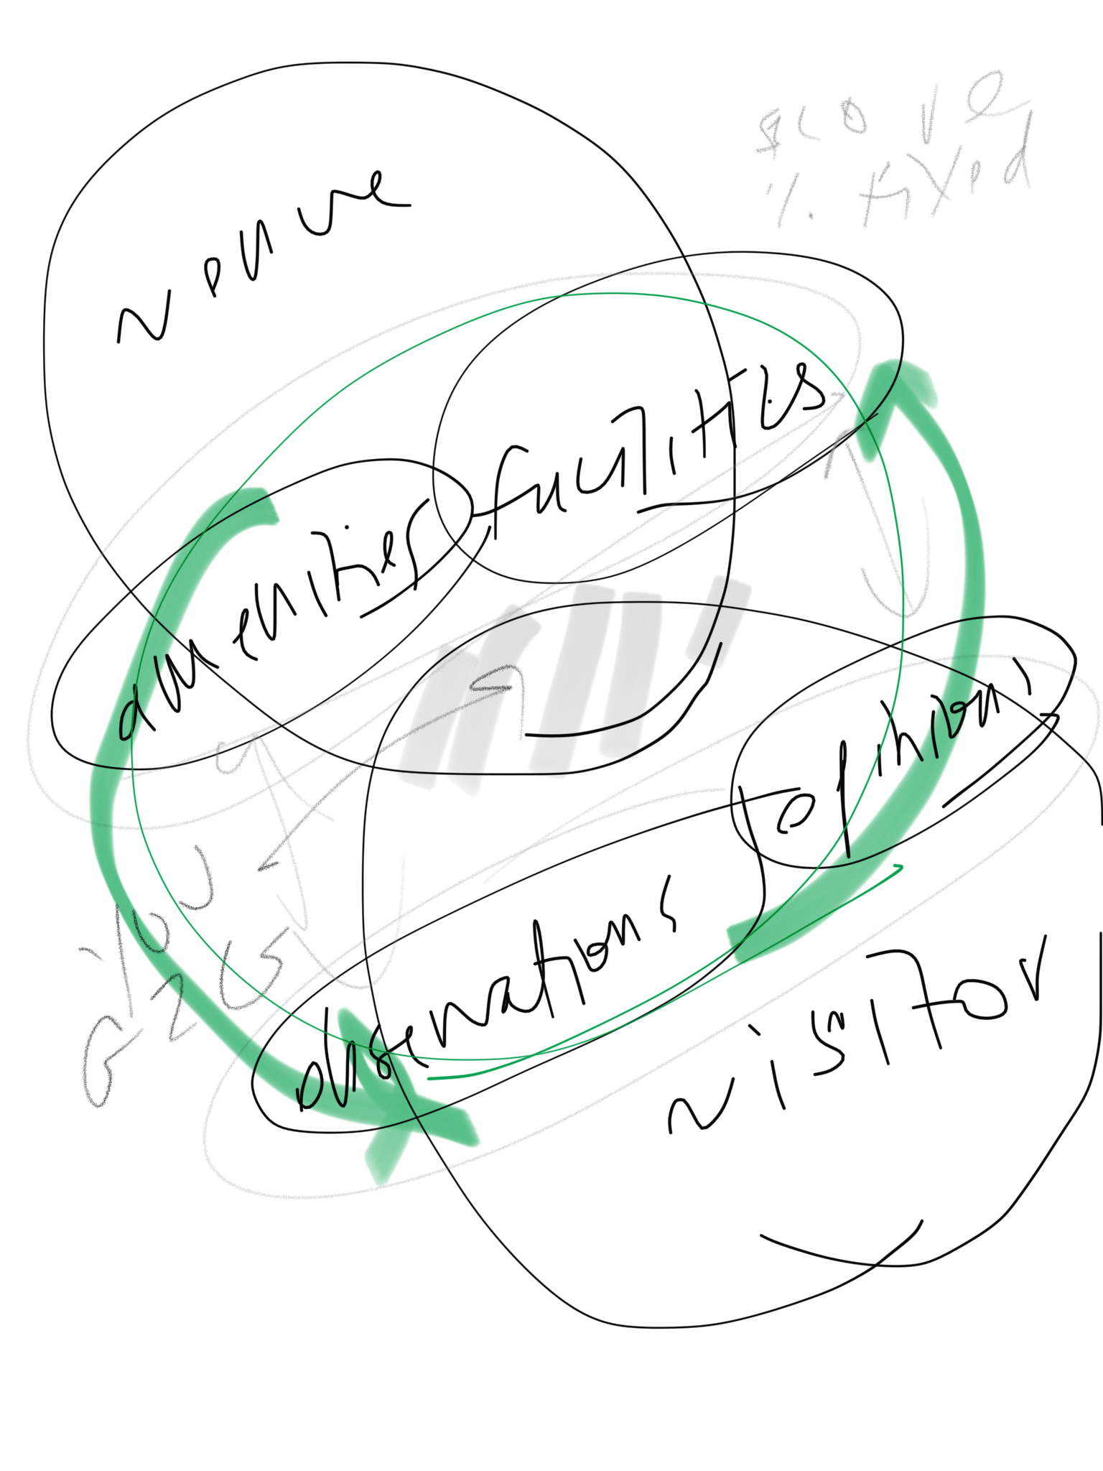
Notes:
Notes from meeting

Slide 38
Porter’s Five Forces

Slide 39
Porter’s Five Forces
Notes:
The Porter’s Five Forces pushes the app to think about the rivalry with competitors. So for threat of new entry there will be a existing player WAZE that could easily add the same feature that the app haves. For Supplier Power, all the power concentrated here since there is not competitive data. The Buyer Power, the commuters have no power. As for substitution, since this subject is unspeakable there is little to none substitution.

Slide 40
SWOT Analysis

Slide 41
SWOT ANALYSIS
S
Strengths
Humorous take on a serious subject
Leveraging well known UX elements, easy to learn and use
W
Weaknesses
At the present time, we have zero data
Data is not proprietary
O
Opportunities
Opportunity to become the market leader
As app gains traction, data collection accelerates
T
Threats
With a low market adoption, data inflow is sparse
Exisitng players in parallel markets, can easily add functionality to duplicate our product
Notes:
In our SWOT analysis, we determined a few things:
-One of our strengths includes providing a humorous approach and solution for a serious subject. We also found ways to utilize well known UX elements, making this solution each to navigate for the user.
-Since data is not proprietary, any competitor can create a similar app utilizing the same data, making this one of our main weaknesses. We also have zero data, since this is the very beginning stage of our project.
-Since is a relatively unique concept, G2G has the opportunity to be the market leader. Since this app is focused on data collection, we have the opportunity to accumulate a wealth of data about facilities.
-Threats to G2G are similar to weaknesses, but on an external level. Data inflow is sparse at the time and could be a slow process. There is also the threat of bigger companies such as Waze or Google Maps who could easily add functionality to their existing apps to mimic what G2G is aiming to accomplish.

Slide 42
…and we’re Good To Go!

